Slide 1
Thinking about high dimensional data
Machine Learning for Single Cell Analysis
Day 1 – Morning session

Slide 2
Goals for this unit
Thinking about data as a point in a high-dimensional space
Introduce vectors, matrices, and common notation
Calculating distances between points
Introduction to the Numpy / Scipy / Pandas / Sklearn ecosystem

Slide 3
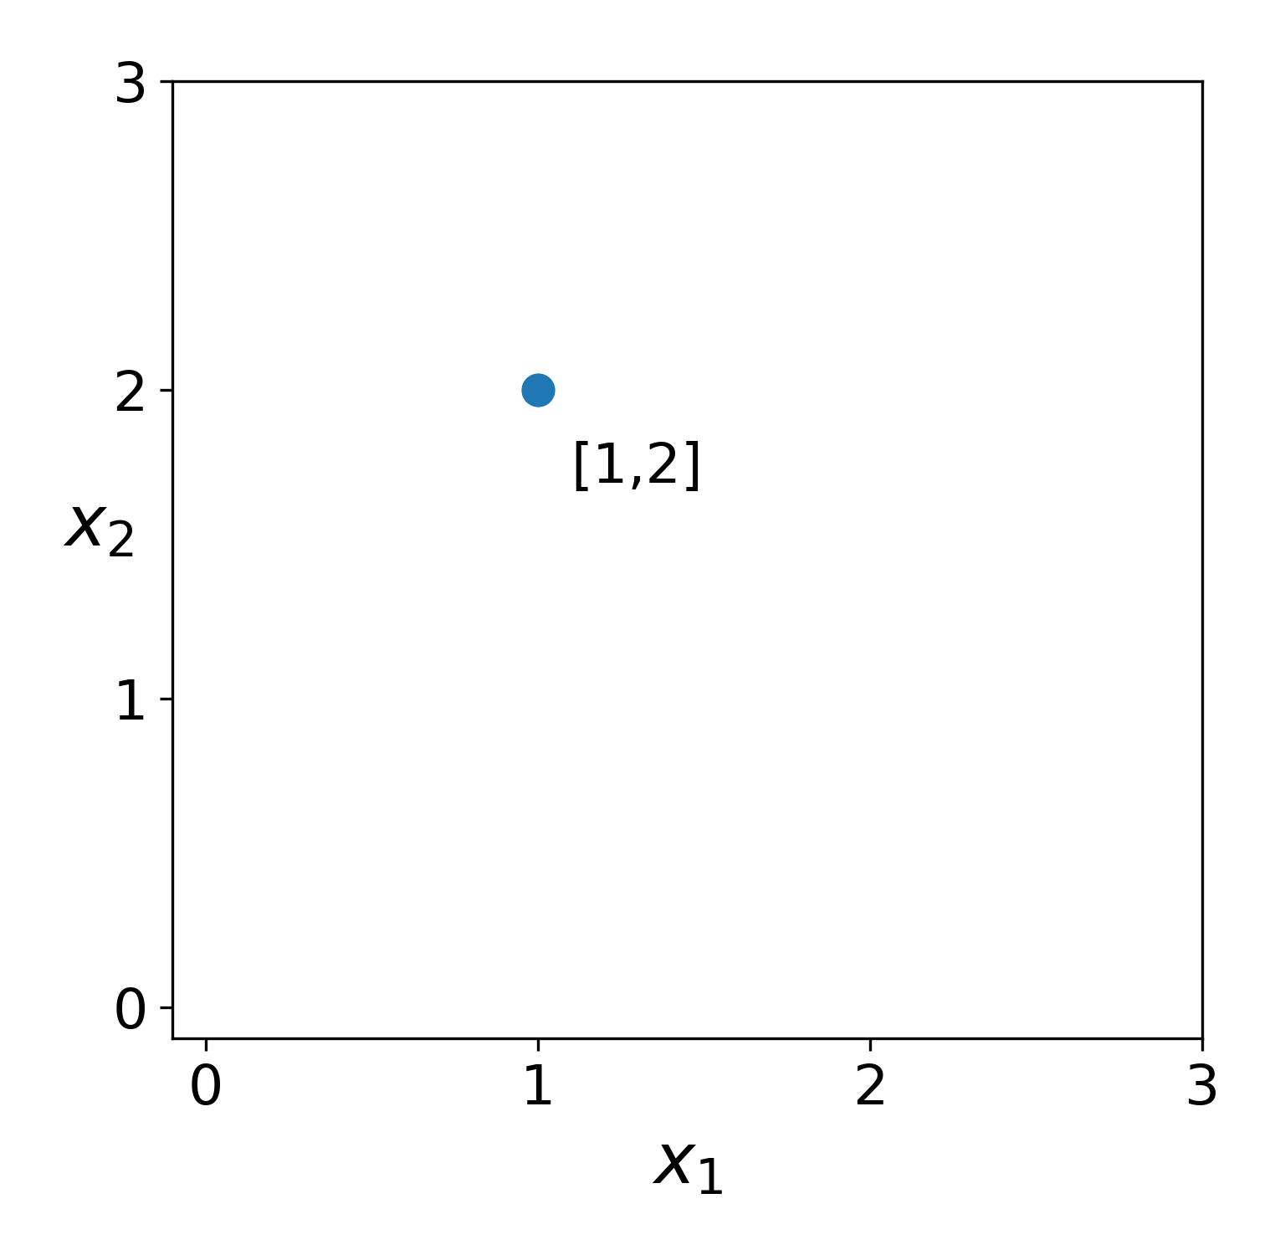
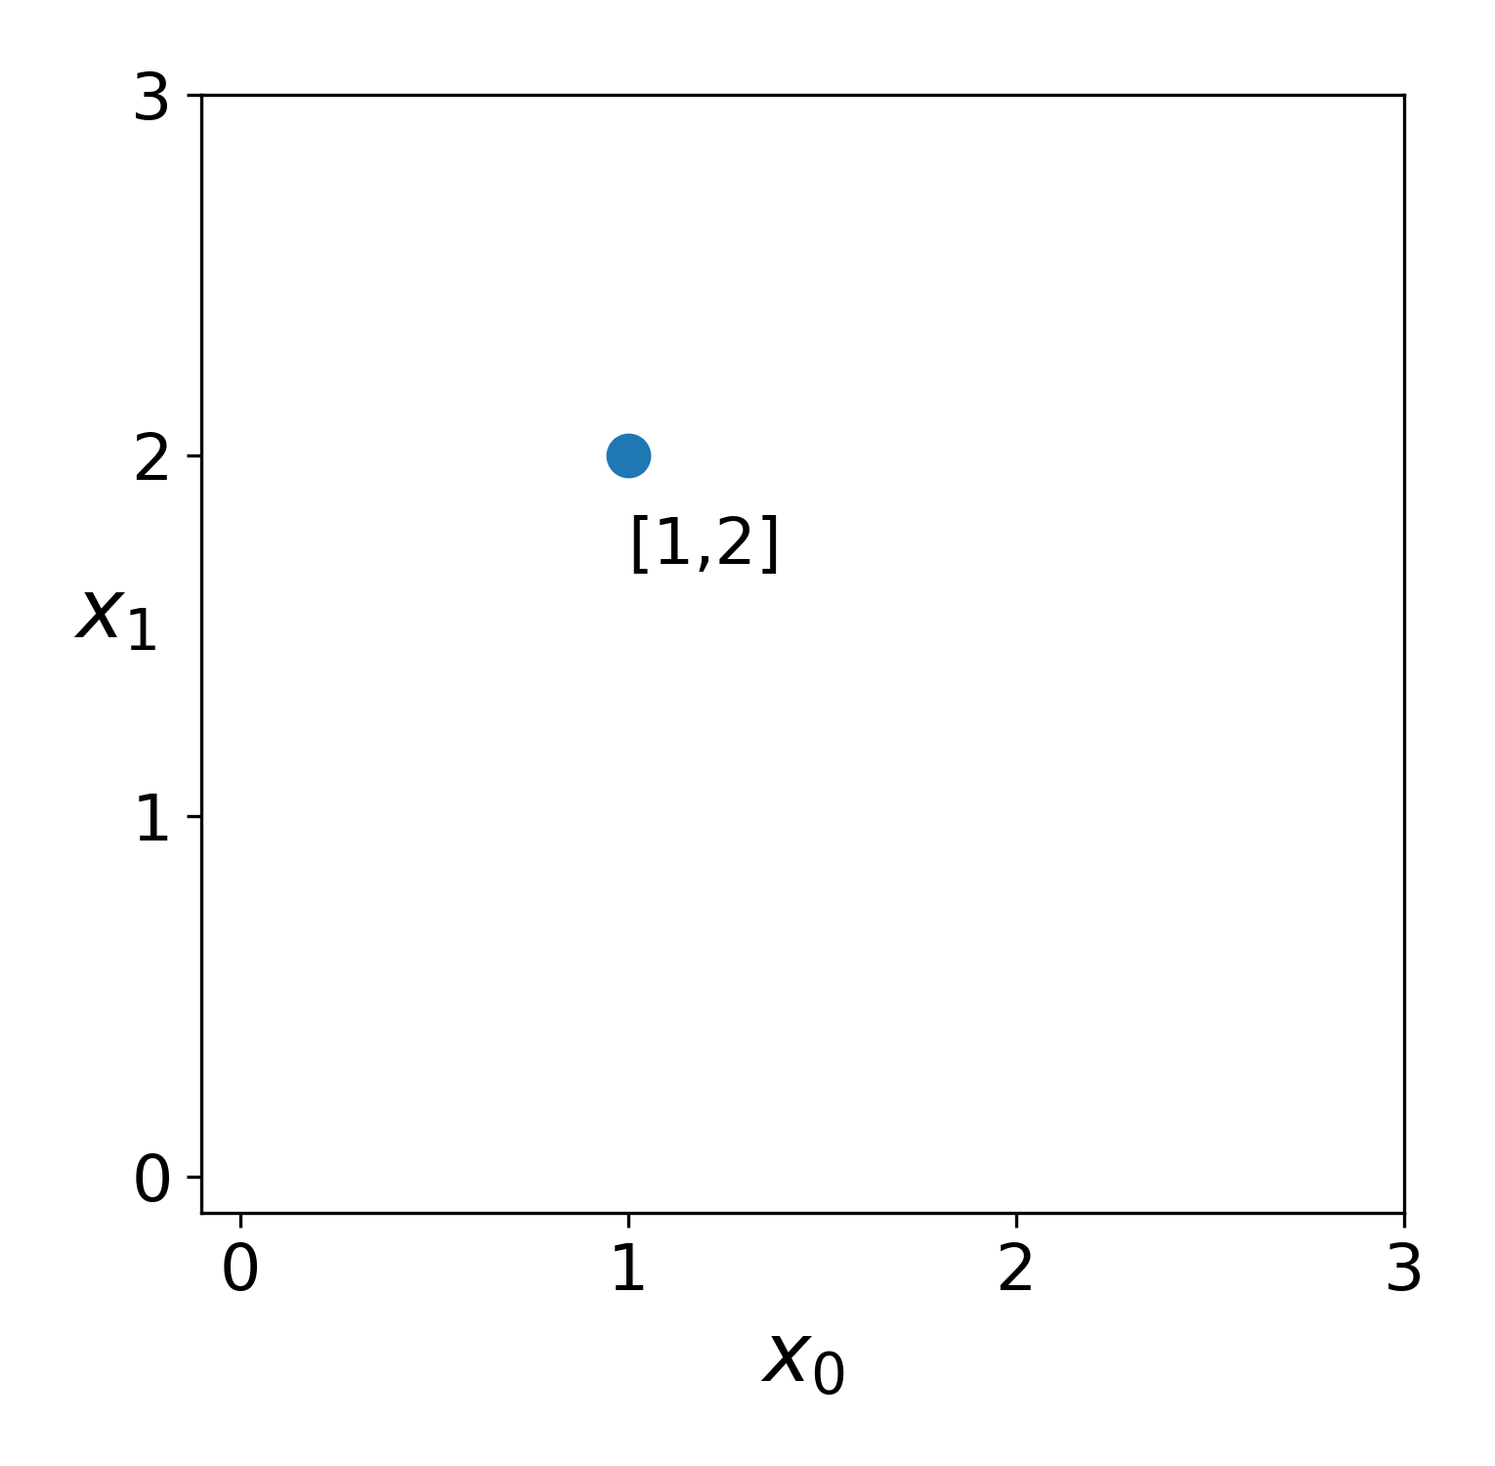
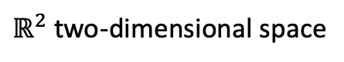

What does “dimensionality” mean?
$ℝ^{2}$ two-dimensional space
$$a$$

Slide 4
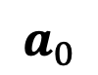
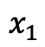
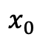
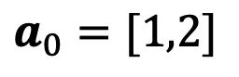
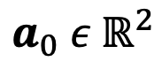
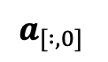
What does “dimensionality” mean?
vector
coordinate space
$ℝ^{2}$ two-dimensional space
$$a_{0} ε{ ℝ}^{2}$$
$$a_{0}=[1,2]$$
$$a_{0}$$
$$x_{0}$$
$$x_{1}$$
features
$$a_{[ :,0]}$$

Slide 5
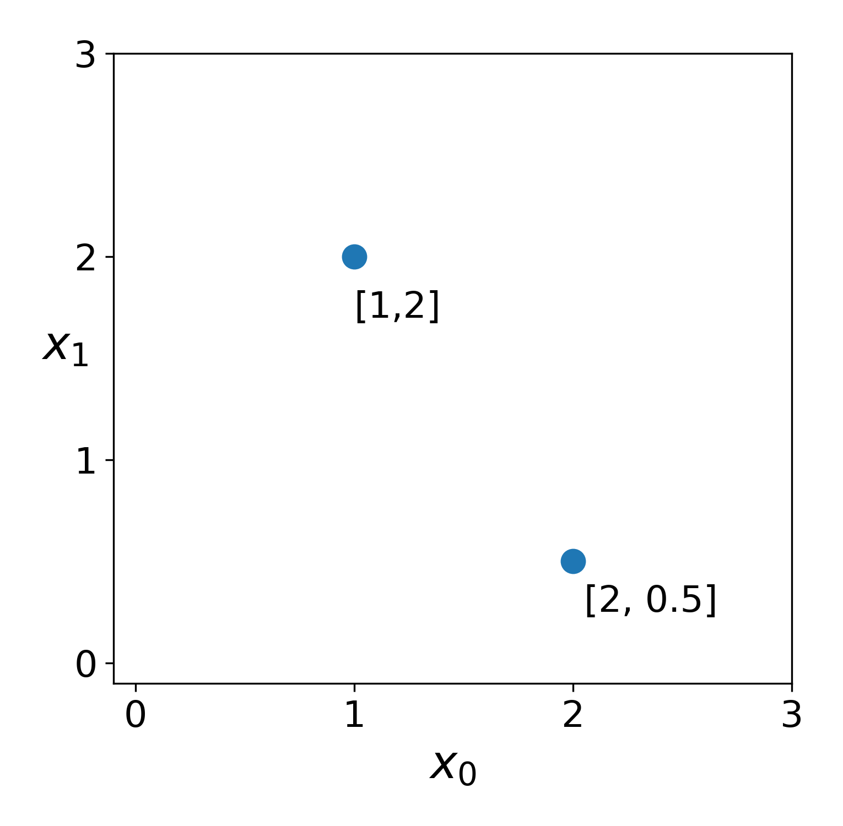
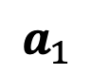
What does “dimensionality” mean?
vector
coordinate space
$ℝ^{2}$ two-dimensional space
$$a_{0} ε{ ℝ}^{2}$$
$$a_{0}=[1,2]$$
$$a_{0}$$
$$x_{0}$$
$$x_{1}$$
features
$$a_{1}$$
$$a_{[ :,0]}$$

Slide 6
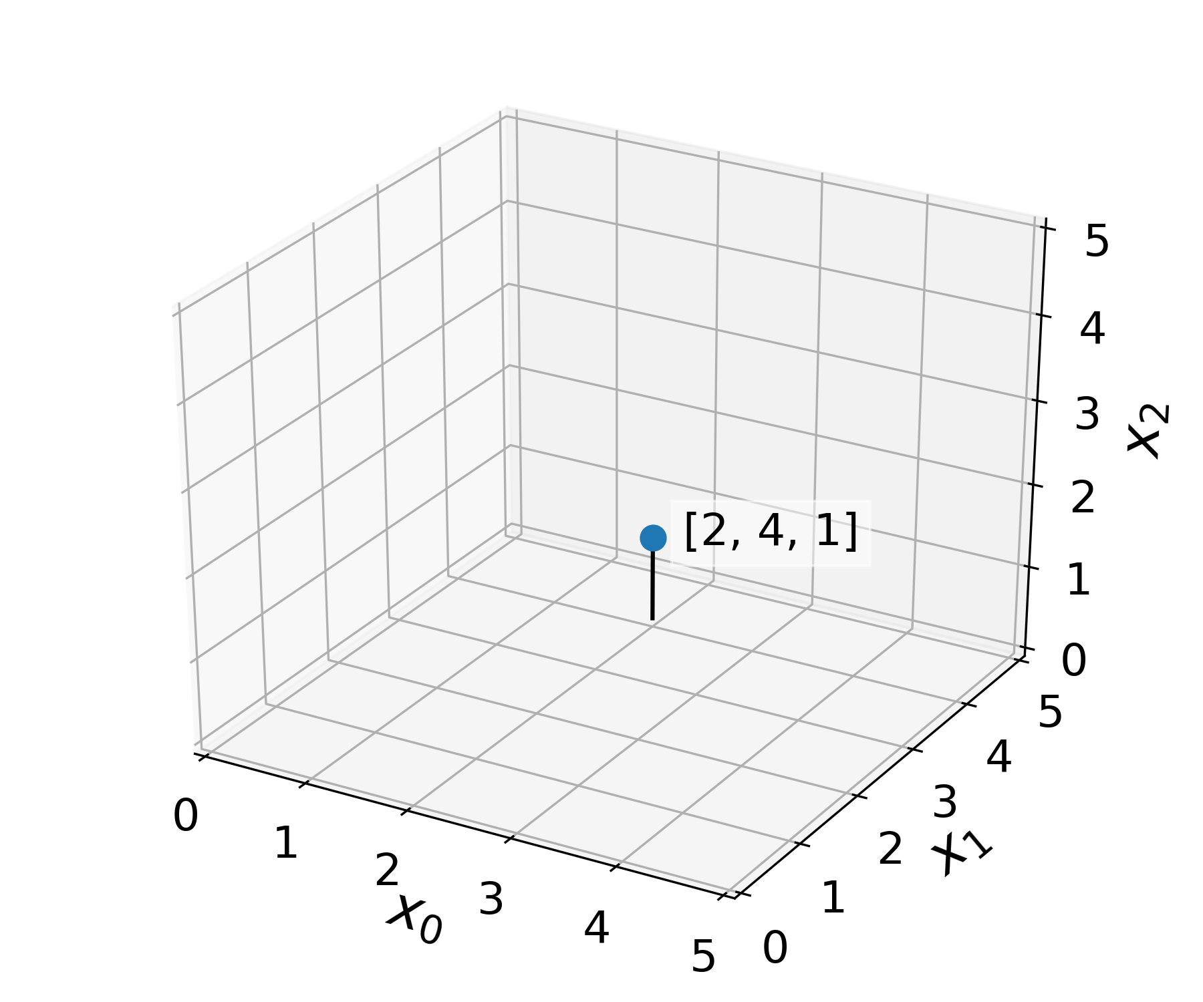
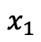
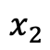
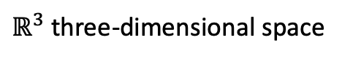
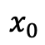
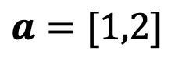
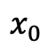
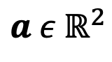
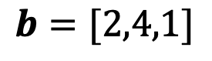

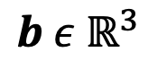
What does “dimensionality” mean?
$$a ε{ ℝ}^{2}$$
$ℝ^{3}$ three-dimensional space
$$a=[1,2]$$
$$x_{0}$$
$$x_{1}$$
$$b ε{ ℝ}^{3}$$
$$b=[2,4,1]$$
$$b$$
$$x_{0}$$
$$x_{1}$$
$$x_{2}$$

Slide 7
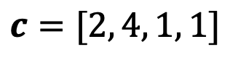
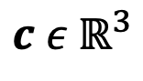
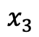
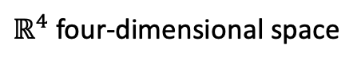
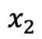
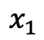
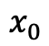
What does “dimensionality” mean?
$$a ε{ ℝ}^{2}$$
$ℝ^{4}$ four-dimensional space
$$a=[1,2]$$
$$x_{0}$$
$$x_{1}$$
$$b ε{ ℝ}^{3}$$
???
$$b=[2,4,1]$$
$$x_{0}$$
$$x_{1}$$
$$x_{2}$$
$$c ε{ ℝ}^{3}$$
$$c=[2, 4, 1, 1]$$
$$x_{0}$$
$$x_{1}$$
$$x_{2}$$
$$x_{3}$$

Slide 8
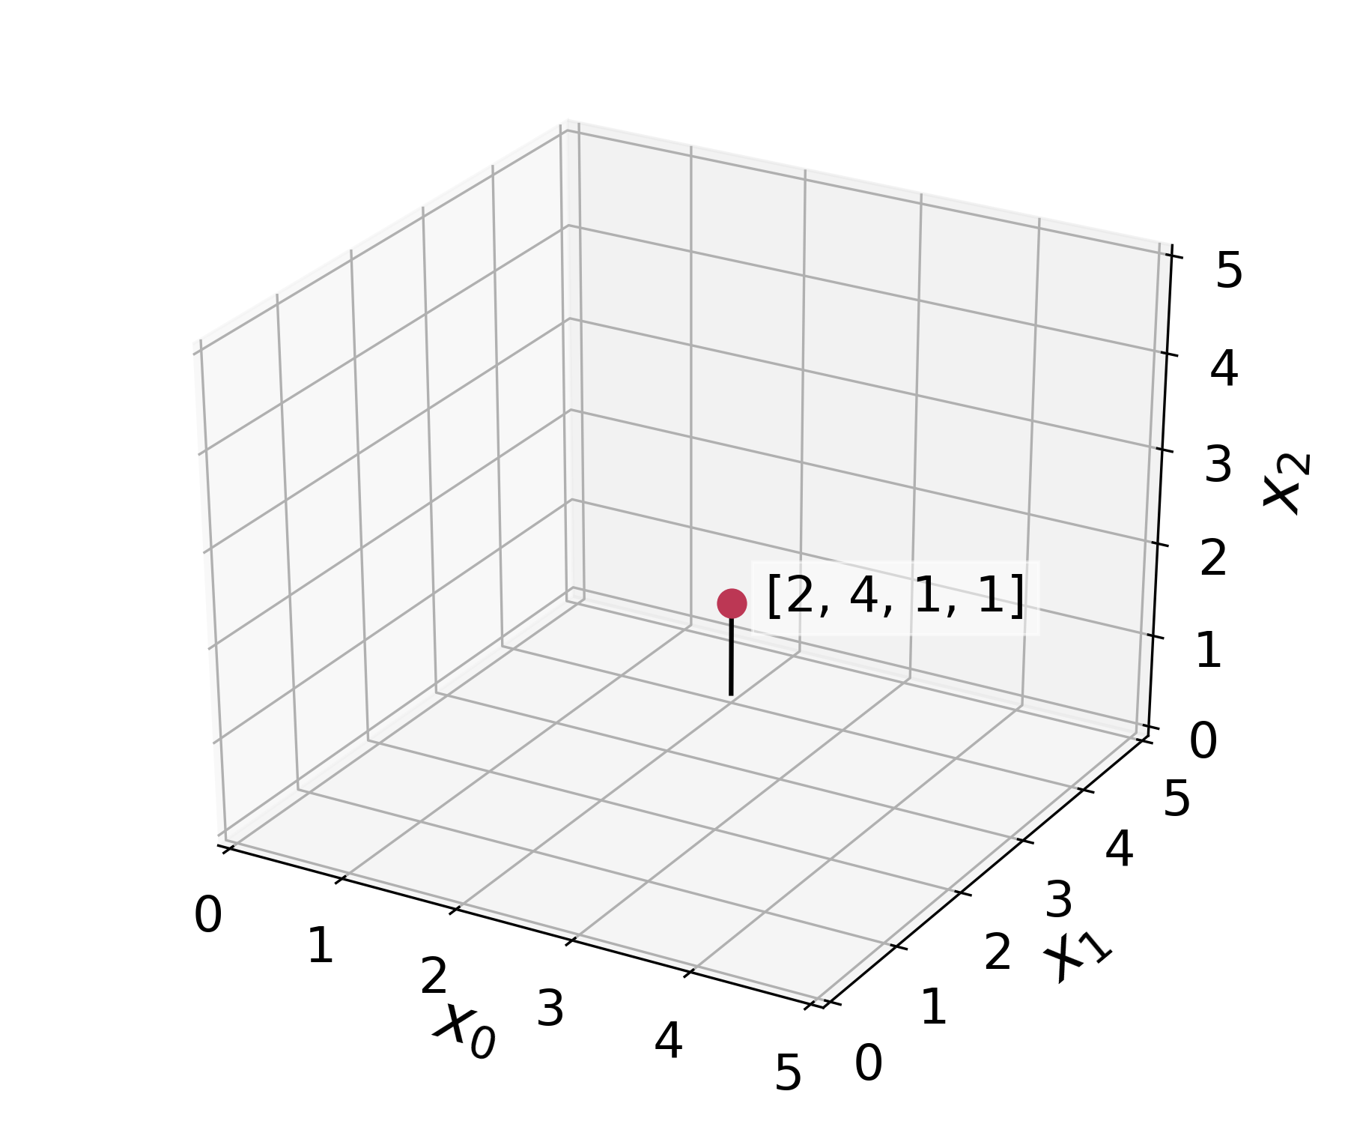


What does “dimensionality” mean?
$$a ε{ ℝ}^{2}$$
$ℝ^{4}$ four-dimensional space
$$a=[1,2]$$
x₃
2
$$x_{0}$$
$$x_{1}$$
$$b ε{ ℝ}^{3}$$
$$b=[2,4,1]$$
$$c$$
1
$$x_{0}$$
$$x_{1}$$
$$x_{2}$$
$$c ε{ ℝ}^{3}$$
0
$$c=[2, 4, 1, 1]$$
$$x_{0}$$
$$x_{1}$$
$$x_{2}$$
$$x_{3}$$

Slide 9
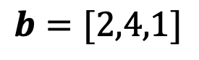
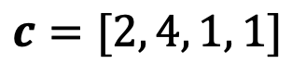
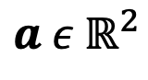
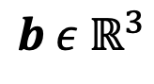
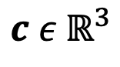
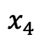
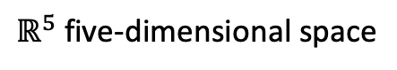
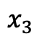
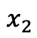
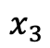
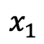
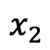
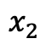
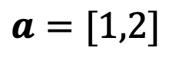
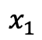
What does “dimensionality” mean?
$ℝ^{5}$ five-dimensional space
$$a ε{ ℝ}^{2}$$
$$a=[1,2]$$
$$x_{1}$$
$$x_{2}$$
$$b ε{ ℝ}^{3}$$
???
$$b=[2,4,1]$$
$$x_{1}$$
$$x_{2}$$
$$x_{3}$$
$$c ε{ ℝ}^{3}$$
$$c=[2, 4, 1, 1]$$
$$x_{1}$$
$$x_{2}$$
$$x_{3}$$
$$x_{4}$$

Slide 10
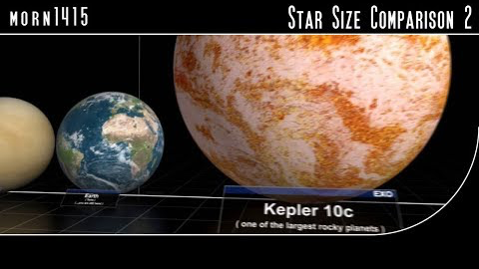
What’s it like to think about high dimensions?
v
Scale of Stars

Slide 11
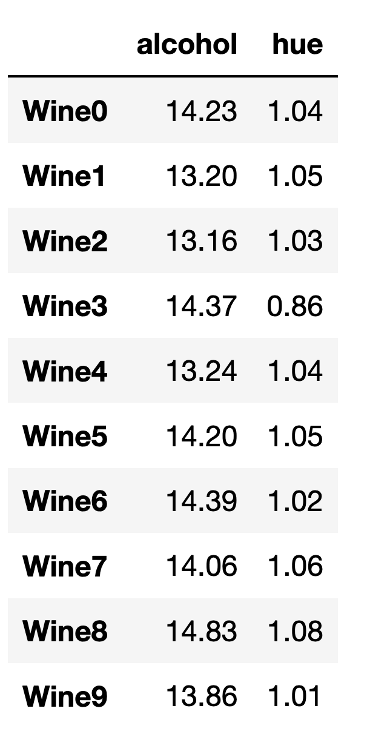
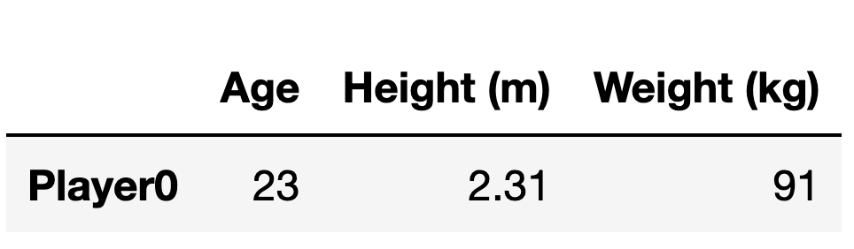
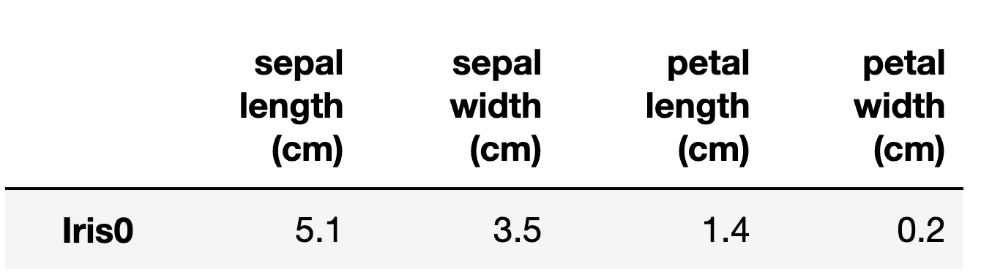
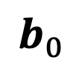
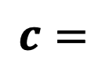






What do x₁ x₂, …, x_{n} represent?
We describe coordinate spaces of $n$ dimensions as $ℝ^{n}$
$$a=$$
$$b=$$
$$a_{0}$$
$$a_{1}$$
$$b_{0}$$
$$b_{1}$$
$$b_{2}$$
$$c=$$
UCI ML Wine Data Set

Slide 12




What if we have more than one observation?
columns (features)
$$a=$$
$$a_{0}$$
$$a_{1}$$
$$A=$$
rows
(observations)
matrix
UCI ML Wine Data Set

Slide 13

What if we have more than one observation?
columns (features)
$$a=$$
$$a_{0}$$
$$a_{1}$$
$$A=$$
$$ε{ ℝ}^{2}$$
matrix
UCI ML Wine Data Set

Slide 14





How do we reference specific observations in a matrix?
$$x_{0}$$
$$x_{1}$$
$$A_{\left[0, :\right]}$$
$$A_{\left[row, column\right]}$$
$$A=$$

Slide 15






What if we have more than one observation?
We can describe coordinate spaces of $n$ dimensions as $ℝ^{n}$
$$x_{0}$$
$$x_{1}$$
$$A_{\left[0, :\right]}=a_{0}=$$
$$A_{\left[0,0\right]}$$
$$A_{\left[0,1\right]}$$
$$A=$$

Slide 16




What if we have more than one observation?
We can describe coordinate spaces of $n$ dimensions as $ℝ^{n}$
$$x_{0}$$
$$x_{1}$$
$$A_{\left[0, :\right]}=$$
$$A_{\left[0,0\right]}$$
$$A_{\left[0,1\right]}$$
$$A=$$
$$A_{\left[9, :\right]}=$$
$$A_{\left[9,1\right]}$$
$$A_{\left[9,1\right]}$$

Slide 17

Exercise!
Loading and plotting the UCI wine dataset

Slide 18

Exercise!
Loading and plotting the UCI wine dataset

Slide 19
Introducing scprep
Code: https://github.com/KrishnaswamyLab/scprep
Docs: https://scprep.readthedocs.io
Modules
filter
io
measure
normalize
plot
reduce
run
select
stats
transform
utils
Plotting functions:
histogram
jitter
marker
marker_plot
plot_gene_set_expression
plot_library_size
rotate_scatter3d
scatter
scatter2d
scatter3d
scree
scree_plot
= scprep.plot.scatter2d

Slide 20
Exercise!
Loading and plotting the UCI wine dataset

Slide 21


How do features differentiate groups within a dataset?

Slide 22
Goals for this unit
Thinking about data as a point in a high-dimensional space
Introduce vectors, matrices, and common notation
Calculating distances between points
Introduction to the Numpy / Scipy / Pandas / Sklearn ecosystem

Slide 23
Introduction to Manifold Learning

Slide 24





How far away is each point from $a_{0}?$
$$a_{1}$$
$$a_{0}$$
$$a_{2}$$

Slide 25








How far away is each point from $a_{0}?$
Euclidean distance
$$a_{1}$$
$$d_{euclidean}\left(a_{0},a_{1}\right)= {\left\|a_{0}−a_{1}\right\|}_{2}^{2}$$
$$\text{2.24}$$
$$=\sqrt{{{(a}_{0,0} −a_{1,0})}^{2}+{{(a}_{0,1} −a_{1,1})}^{2}}$$
$$a_{0}$$
$$a_{2}$$
$$=\sqrt{{(1 −2)}^{2}+{(2 −4)}^{2}}$$
$$≈2\text{.24}$$

Slide 26




How far away is each point from $a_{0}?$
$$a_{1}$$
$$a_{0}$$
$$a_{2}$$

Slide 27
How far away is each point from $a_{0}?$
$$a_{1}$$
$$a_{0}$$
$$a_{2}$$

Slide 28


How far away is each point from $a_{0}?$
$$a_{1}$$
$$a_{0}$$
$$a_{2}$$

Slide 29
How far away is each point from $a_{0}?$
$$a_{1}$$
$$a_{0}$$
$$a_{2}$$

Slide 30







How far away is each point from $a_{0}?$
Manhattan distance
$$a_{1}$$
$$d_{manhattan}\left(a_{0},a_{1}\right)=|a_{0,1} −a_{1,1}|$$
$$={|a}_{0,0} −a_{1,0}|+|a_{0,1} −a_{1,1}|$$
$$a_{0}$$
$$a_{2}$$
$$=|1 −2|+|2−4|$$
$$=3$$

Slide 31





How far away is each point from $a_{0}?$
$$a_{1}$$
$$a_{1}$$
$$a_{2}$$
$$a_{2}$$
$$a_{0}$$
$$a_{0}$$

Slide 32

Exercise!
Calculating distances
Dist
Notes:
Are the green and orange cultivars really different? How could we tell?

Slide 33
Exercise!
Calculating distances
Distance defines structure in a dataset
How different are two data points?
How many types exist in my dataset?
Which types are closest to each other?
Which features vary between dissimilar groups of data?
Dist
Notes:
Are the green and orange cultivars really different? How could we tell?

Slide 34



What is a manifold?
Surface in $ℝ^{3}$
Local view in $ℝ^{2}$
Locally smooth
Locally Euclidean
Generally, lower dimensional than the ambient space (i.e. a subspace)
Notes:
Mention that the “manifold dimensionality” of this manifold is 2d

Slide 35




Examples of manifolds
Wolfram
Notes:
Mention that the “manifold dimensionality” of this manifold is 2d

Slide 36

Examples of manifolds
Waddington’s landscape
Wolfram
ptglab.com
Notes:
Mention that the “manifold dimensionality” of this manifold is 2d

Slide 37
Examples of manifolds
Waddington’s landscape
Smooth transitions between states
Small changes in gene expression are linear
Wolfram
ptglab.com
Notes:
Mention that the “manifold dimensionality” of this manifold is 2d

Slide 38

NHV
MEX
Notes:
Ask, what is the intrinsic dimensionality of a sphere?

Slide 39

How far is NHV -> MEX?

Slide 40

How far is NHV -> MEX?

Slide 41

How far is NHV -> MEX?

Slide 42
How far is NHV -> MEX?
Manifold distance
Euclidean distance

Slide 43

Is a circle locally Euclidean?

Slide 44

Is a circle locally Euclidean?
# segments = 2

Slide 45

Is a circle locally Euclidean?
# segments = 4

Slide 46

Is a circle locally Euclidean?
# segments = 100

Slide 47
Is a circle locally Euclidean?
Key Insight:
Manifolds are locally Euclidean,
but not globally Euclidean

Slide 48
Is a circle locally Euclidean?
Key Insight:
Manifolds are locally Euclidean,
but not globally Euclidean
How do we define local versus global when we only have a collection of points?

Slide 49



The swiss roll is a plane ($ℝ^{2}$) embedded in $ℝ^{3}$
True manifold
Data sampled from manifold

Slide 50


How do we quantify close (local) versus far (global) in a dataset?
$$a_{1}$$
$$a_{0}$$
$$a_{2}$$

Slide 51



How do we quantify close (local) versus far (global) in a dataset?
$$a_{1}$$
$$a_{0}$$
$$a_{2}$$
Notes:
Point out that A2 would be “sort of close” in Euclidean space

Slide 52

How do we quantify close (local) versus far (global) in a dataset?
$$a_{1}$$
$$a_{0}$$
$$a_{2}$$

Slide 53
How do we quantify close (local) versus far (global) in a dataset?
$$a_{1}$$
$$a_{0}$$
$$a_{2}$$
5 closest points
Far

Slide 54

How do we quantify close (local) versus far (global) in a dataset?
Point out that A2 would be “sort of close” in Euclidean space
Edge
5 closest points
Far

Slide 55






What is a “graph”?
Plot
Graph
$$a_{1}$$
$$a_{0}$$
$$a_{2}$$
$$G=(V,E)$$
$=V$ = vertices / nodes
$=E$ = edges

Slide 56


What is a “graph”?
Things that can be modelled as a graph
Graph
Thing | Vertices | Edges
Internet | Computers | Network connections
Traffic | Intersections | Roads
Social network | People | Friendships
Cell similarities | Cells | Similarity relationships
$$G=(V,E)$$
$=V$ = vertices
$=E$ = edges

Slide 57




Graph walks approximate manifold distances
Shortest path between points
$$a_{1}$$
$$a_{0}$$
$$a_{1}$$
$$a_{2}$$
$$a_{2}$$

Slide 58


Graph walks approximate manifold distances
Shortest path between points
$$a_{1}$$
$$a_{0}$$
$$a_{1}$$
$$a_{2}$$
1
2
3
4
5
$$a_{2}$$
$d_{geodesic}\left(a_{1},a_{2}\right)=shortestpath(a_{1},a_{2}$)
$$=5$$

Slide 59


Graph walks approximate manifold distances

Slide 60

What if the data isn’t entirely connected?
New dataset

Slide 61

What if the data isn’t entirely connected?
New dataset

Slide 62

What if the data isn’t entirely connected?
New dataset
?

Slide 63

What if the data isn’t entirely connected?
New dataset
$$d_{geodesic}=inf$$

Slide 64
What if the data isn’t entirely connected?
New dataset
inf
inf
$$d_{geodesic}=inf$$

Slide 65

Summary: learning graphs from data

Slide 66
Summary: learning graphs from data

Slide 67
Exercise!
To do: How does choice of k affect our approximation of manifolds with different shapes?

Slide 68

Matrix representations of graphs
G
A adjacency matrix
D degree matrix
1
1
2
4
2
3
2
1
2
5
Laplacian matrix
Creating visualizations
Clustering
Denoising data associated with the nodes

Slide 69
Exercise!
To do: figure out how to get people to figure out
the “shape” of a dataset without being able to easily visualize it.

Slide 70
Graph notation

